Slide 1

EECS 370 - Lecture 9
Sequential Logic
Live Poll + Q&A: slido.com #eecs370
Poll and Q&A Link

Slide 2
Announcements
P1s & M due tonight!
P2a due Thu 2/16
Walkthrough available on website
HW 2 due Mon 2/6

Slide 3
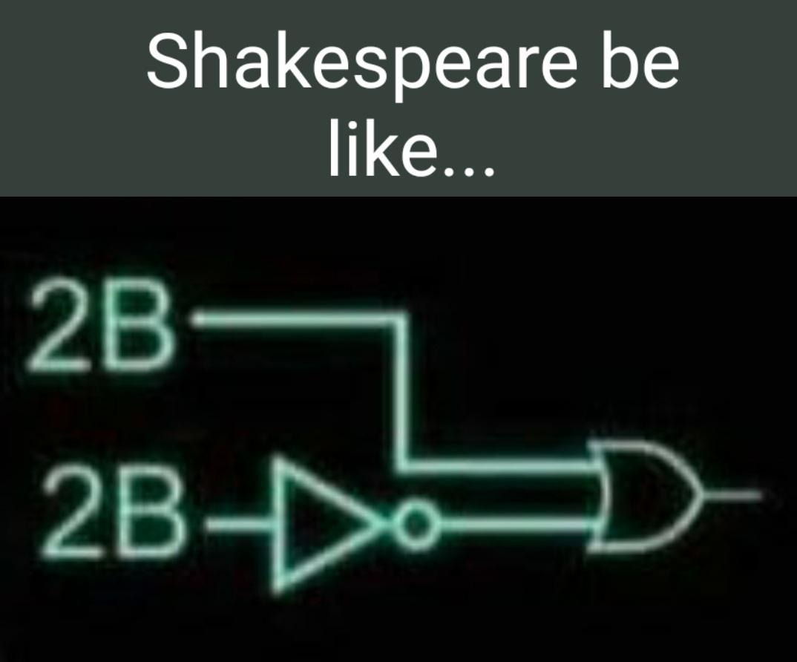
Next few lectures: Digital Logic
Lectures 1-7:
LC2K and ARMv8/LEGv8 ISAs
Converting C to Assembly
Function Calls
Linking
Lecture 8:
Finish up linking
Combinational Logic
Today:
Sequential Logic

Slide 4
Sequential Logic
Can we build a processor out of these combinational elements?
How to build something like a program counter (PC)?
Increment it for every instruction… fine, use an adder
But only increment it once ready to move on to next instruction
That takes a finite amount of time… until then we need to "remember" the current value
Combinational logic's output is determined from current input
But computers have "state" – they remember previous inputs and behave differently based on its history
Examples of state
Registers
Memory
PC
Sequential logic's output depends not only on current input, but also the current state
This lecture will show you how to build sequential logic from gates
Key is feedback

Slide 5
Using feedback to "remember"
Q
This remembers its initial value!
Very basic memory
What's wrong with this, though?

Slide 6
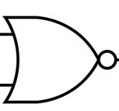
Let's look at the following circuit
R
Q
S R Q Q
0 0 Q Q
Useful identify:
NOR(0,X)= NOT(X)
0
Q
S
X
Q
1
When R=S=0, turns into our memory element!
Q
Live Poll + Q&A: slido.com #eecs370

Slide 7
Let's look at the following circuit
R
= 1
Q
= 0
S R Q Q
0 0 Q Q
0 1 0 1
Q
= 1
S
= 0
What is the value of Q if R is 1 and S is 0?

Slide 8
Let's look at the following circuit
R
= 0
Q
= 1
S R Q Q
0 0 Q Q
0 1 0 1
1 0 1 0
Q
= 0
S
= 1
What is the value of Q if R is 0 and S is 1?
Poll

Slide 9
SR Latch
So this circuit (an SR latch):
"Sets" Q to 1 when S=1 R=0
"Resets" Q to 0 when S=0 R=1
"Latches" Q when S=0 R=0
What about when S=1 R=1 ?
R
Q
S R Q Q
0 0 Q Q
0 1 0 1
1 0 1 0
1 1 0 0
Q
S
BAD! Why?

Slide 10
SR Latch – Undefined behavior
If S=1, R=1, then Q and it's inverse are both 0
If inputs then change to S=0, R=0, we get this circuit
This is unstable! Output rapidly oscillates between 0 and 1
R
= 0
Q
= 0 -> 1 -> 0 -> 1 …
Q
= 0 -> 1 -> 0 -> 1 …
S
= 0

Slide 11
Improving SR Latch
SR Latch works great at saving a bit of data…
Unless S=R=1, even for a fraction of a second
Idea: let's prevent that from happening by adding AND gates in front of each input
Impossible for R and S to both be 1
D
R
Q
Gating signal
Q
S
G

Slide 12
Transparent D Latch
Q
Q
S
Gating signal
G
D G Q Q
0 0 Q Q
0 1 0 1
1 0 Q Q
1 1 1 0
D
Q
Set state
is retained
when gate is low
Next state
is set
G
No invalid states ☺

Slide 13
Transparent D Latch
When G ("gate") is high, Q=D (the latch is "transparent")
When G is low, Q "latches" to the value of D at that instant and remembers, even if D changes later
D G Q Q
0 0 Q Q
0 1 0 1
1 0 Q Q
1 1 1 0
D
Q
Set state
is retained
when gate is low
Next state
is set
G
No invalid states ☺

Slide 14
D-Latch Timing Diagram
D
G
Q

Slide 15
D-Latch Timing Diagram
D
G
Q
Q changes when G is high.
Q is preserved when G is low
Indicates uncertainty of initial state

Slide 16
Is D-Latch Sufficient?
Can we use D-latches to build our PC logic?
Idea:
Use 32 latches to hold current PC, send output Q to memory
Also pass output Q into 32-bit adder to increment by 1 (for word-addressable system)
Wrap sum around back into D as "next PC"
Once ready to execute next instruction, set G high to update
32
32
Full
Adder
Circuit
32
D
Q
1
G

Slide 17
Shortcoming of D-Latch
Problem: G must be set very precisely
Set high for too short: latch doesn't have enough time for feedback to stabilize
Set high for too long: Signal may propagate round twice and increment PC by 2 (or more)
Challenging to design circuits with exactly the right durations
Not just a problem for PC, much of our processor will involve logic like this
32
32
Full
Adder
Circuit
32
D
Q
1
G

Slide 18
Adding a Clock to the Mix
We can solve this if we introduce a clock
Alternating signal that switches between 0 and 1 states at a fixed frequency (e.g., 1 GHz)
Only store the value the instant the clock changes (i.e. the edge)
rising edge
falling edge

Slide 19
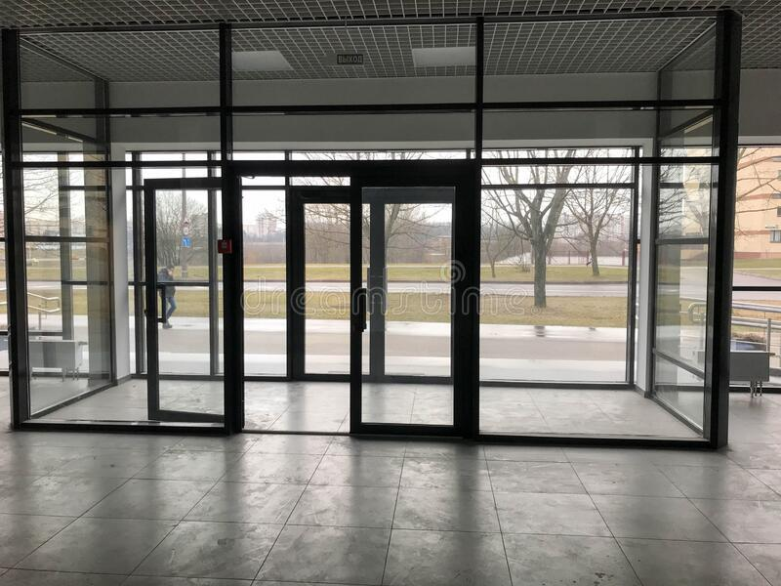
Adding a Clock to the Mix
Data
D
q
d
Q
G
G
Clock
We won't discuss it further here, but this circuit sets Q=D ONLY when clock transitions from 0 -> 1
Intuitively, the design works by inverting the Gate signals, so only one passes at a time (like a double set of sliding doors)
Live Poll + Q&A: slido.com #eecs370

Slide 20
Extra Slides
1
Data
0
D
q
d
Q
G
G
Clock
When "Clock" is low, first latch is transparent
But Q is latched to previous value of q

Slide 21
Extra Slides
1
Data
1
D
q
d
Q
G
G
Clock
When "Clock" is high, q latches to D's value
Second latch is transparent
Q now holds value of D from the instant Clock went high
Won't change again until the next instant clock goes from low to high

Slide 22
Extra Slides
Data
D
q
d
Q
G
G
Clock
Data
D
Q
Clock
q
Q
Latching starts
Value remembered by flip-flop
Latching edge

Slide 23
D Flip-Flop Timing Diagram
Data
Clock
Q

Slide 24
What happens if Data changes on clock edge?
Data
Clock
BAD
Unpredictable: Q could be high, low or in a meta-stable state
Likely need to increase your clock period to allow enough time for signal propagation
Q

Slide 25
Latches vs Flip-flops
D
Q
D
Q
D
Q
En
G
D Latch
D Flip-flop
Enabled D Flip-flop
(only updates on clock edge if 'en' is high)

Slide 26
Finite State Machines
So far we can do two things with gates:
Combinational Logic: implement Boolean expressions
Adder, MUX, Decoder, logical operations etc
Sequential Logic: store state
Latch, Flip-Flops
How do we combine them to do something interesting?
Let’s take a look at implementing the logic needed for a vending machine
Discrete states needed: remember how much money was input
Store sequentially
Transitions between states: money inserted, drink selected, etc
Calculate combinationally or with a control ROM (more on this later)

Slide 27
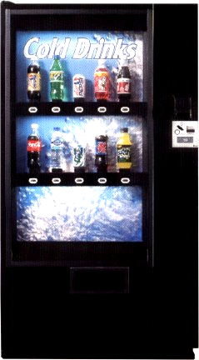
Input and Output
Inputs:
Coin trigger
Refund button
10 drink selectors
10 pressure sensors
Detect if there are still drinks left
Outputs:
10 drink release latches
Coin refund latch

Slide 28
Operation of Machine
Accepts quarters only
All drinks are $0.75
Once we get the money, a drink can be selected
If they want a refund, release any coins inserted
No free drinks!
No stealing money.

Slide 29
Building the controller
Finite State Machine
An abstract model describing how the machine should be have under a fixed set of circumstances (i.e. finite states)
Remember how many coins have been put in the machine and what inputs are acceptable
Read-Only Memory (ROM)
A cheaper way of implementing combinational logic
Define the outputs and state transitions
Custom combinational circuits
Reduce the size (and therefore cost) of the controller

Slide 30
Finite State Machines
A Finite State Machine (FSM) consists of:
K states: S = {s1, s2, … ,sk}, s1 is initial state
N inputs: I = {i1, i2, … ,in}
M outputs: O = {o1, o2, … ,om}
Transition function T(S,I) mapping each current state and input to next state
Output Function P(S) or P(S,I) specifies output
P(S) is a Moore Machine
P(S,I) is a Mealy Machine

Slide 31
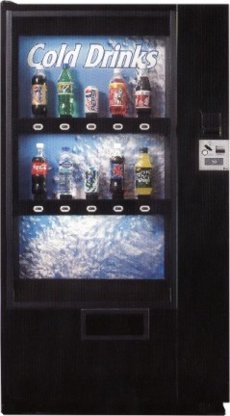
FSM for Vending Machine
Reset
0 coins
Coin trigger
Refund button
Drink Select

Slide 32
FSM for Vending Machine
Poll: How many flip-flops would we need to remember which state we're in?
Reset
Refund
0 coins
1 coin
Vend drink
Refund
Refund
Refund
3 coins
2 coins
Ran out of specific drink selection
Coin trigger
Refund button
Drink Select
Is this a Mealy or Moore Machine?
This is Mealy: Mealy output is based on current state AND input
Poll: Mealy or Moore?
Live Poll + Q&A: slido.com #eecs370

Slide 33
Implementing an FSM
Poll: How cheaply do you think we can build one of these controllers?
Outputs
Implement
transition
functions
(using a ROM and
combinational circuits)
Inputs
Current state
D
Q
Next state
D
Q
2-bit state

Slide 34
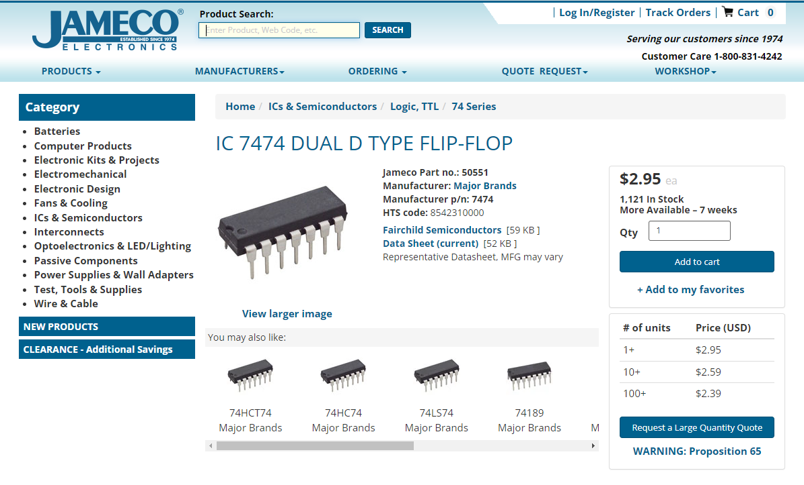
Implementing an FSM
Let's see how cheap we can build this vending machine controller!
Jameco.com sells electronic chips we can use
D-Flip-flops: $3, includes several in one package
For custom combinational circuits, would need to design and send to a fabrication facility
Thousands or millions of dollars!!
Alternative?

Slide 35
Implementing Combinational Logic
A
B
O
C
0
0
0
0
1
1
1
1
0
0
1
1
0
0
1
1
0
1
0
1
0
1
0
1
0
1
0
1
0
1
1
1
If I have a truth table:
Either implement this using combinational logic:
…or literally just store the entire truth table in a memory and "index" it by treating the input as a number!
Can be implemented cheaply using "Read Only Memories", or "ROMS"
A
B
0
C
{A,B,C}
addr_in
0
1
0
1
0
1
1
1
3
data_out
{O}

Slide 36
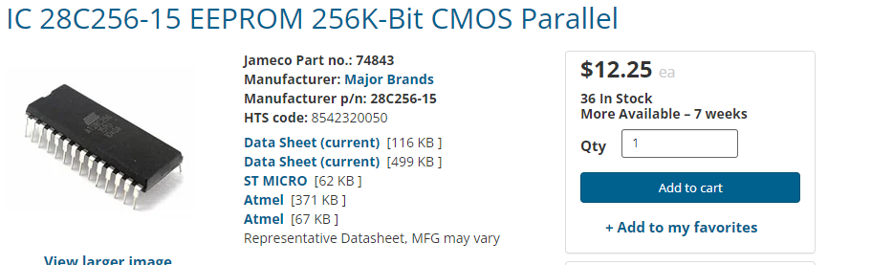
ROMs and PROMs
Read Only Memory (ROM)
Array of memory values that are constant
Non-volatile (doesn’t need constant power to save values)
Programmable Read Only Memory
Array of memory values that can be written exactly once
Electronically Erasable PROM (EEPROM)
Can write to memory, deploy in field
Use special hardware to reset bits if need to update
256 KBs of EEPROM costs ~$10 on Jameco
Much better then spending thousands on design costs unless we're gonna make tons of these

Slide 37
8-entry 4-bit ROM
3x8
Decoder
address
0
1
1
A₀
0
A₁
A₂
3
Reminder: A decoder sets exactly one output high based on input
A diode only allows current to flow in one direction.
It prevents a ‘1’ from propagating to other lines.
7
D₀
1
D₁
0
D₂
0
D₃
1
data

Slide 38
8-entry 4-bit ROM
Input | Output
000
001
010
011
100
101
110
111
3x8
Decoder
address
0
A₀
A₁
A₂
3
7
This ROM corresponds to this truth table
D₃
D₂
D₁
D₀
data

Slide 39
8-entry 4-bit ROM
Poll: What's the formula for size of ROM needed?
Input | Output
000 | 1001
001 | 0100
010 | 0010
011 | 1001
100 | 0010
101 | 0001
110 | 1000
111 | 0000
3x8
Decoder
address
0
A₀
A₁
A₂
3
7
This ROM corresponds to this truth table
D₃
D₂
D₁
D₀
data

Slide 40
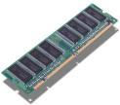
Aside: Other Memories
Static RAM (random access memory)
Built from sequential circuits
Takes 4-6 transistors to store 1 bit
Fast access (< 1 ns access possible)
Dynamic RAM
Built using a single transistor and a capacitor
1’s must be refreshed often to retain value
Slower access than static RAM
Much more dense layout than static RAM
Both require constant power, or they will lose their data (i.e. are volatile)
These will be used to build computer memory hierarchies (later in class)

Slide 41
Implementing Combinational Logic
Custom logic
Pros:
Can optimize the number of gates used
Cons:
Can be expensive / time consuming to make custom logic circuits
Lookup table:
Pros:
Programmable ROMs (Read-Only Memories) are very cheap and can be programmed very quickly
Cons:
Size requirement grows exponentially with number of inputs (adding one just more bit doubles the storage requirements!)

Slide 42



Controller Design So far
What would a ROM for this look like?
Drink Release
Latches
Drink selectors
Big Memory
(24 bit address,
13 bit output)
x10
Pressure Sensors
refund
D Q
Coin release
D Q
coin
Clock/Event
2-bit state

Slide 43
ROM for Vending Machine
Size of ROM is (# of ROM entries * size of each entry)
# of ROM entries = 2^{input_size} = 2²⁴
Size of each entry = output size = 13 bits
We need 2²⁴ entry, 13 bit ROM memories
218,103,808 bits of ROM (26 MB)
Biggest ROM I could find on Jameco was 4 MB @ $6
Need 7 of these at $42??
Let's see if we can do better

Slide 44
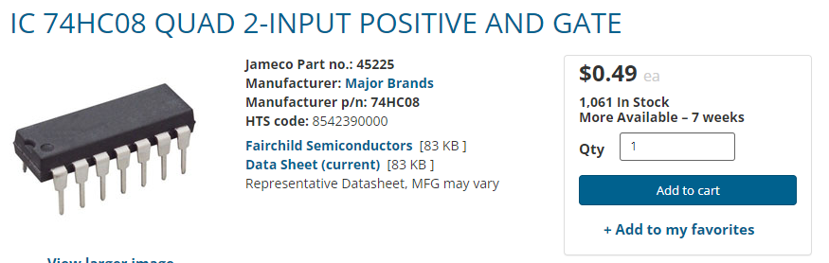
Reducing the ROM needed
Idea: let's do a hybrid between combinational logic and a lookup table
Use basic hardware (AND / OR) gates where we can, and a ROM for everything more complicated
AND / OR gates are mass producible & cheap!
~$0.15 each on Jameco

Slide 45
Reducing the ROM needed
Observation: overall logic doesn't really need to distinguish between which button was pressed
That's only relevant for choosing which latch is released, but overall logic is the same
Replace 10 selector inputs and 10 pressure inputs with a single bit input (drink selected)
Use drink selection input to specify which drink release latch to activate
Only allow trigger if pressure sensor indicates that there is a bottle in that selection. (10 2-bit ANDs)

Slide 46
Putting it all together
Drink selector
Pressure Sensor
Drink Release
10 input
OR gate
32
5×32 decoder
Drink Release
Latches
refund
D Q
Coin release
D Q
coin
Clock/Event
2-bit state

Slide 47
Total cost of our controller
Now:
2 current state bits + 3 input bits (5 bit ROM address)
2 next state bits + 2 control trigger bits (4 bit memory)
2⁵ × 4 = 128 bit ROM
1-millionth size of our 26 MB ROM😬
Total cost on Jameco:
Flip-flops to store state: $3
ROM to implement logic: $3
AND/OR gates: $5
Total: $11
Could probably do a lot cheaper if we buy in bulk

Slide 48
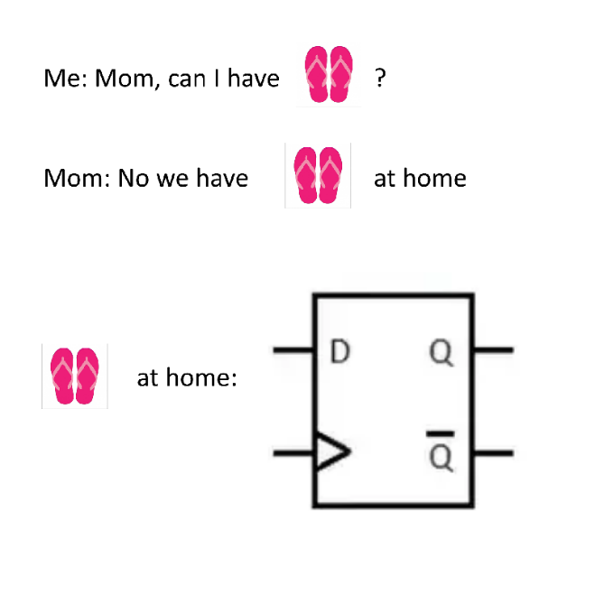

Next Time
Introduce first processor implementation
Lingering questions / feedback? I'll include an anonymous form at the end of every lecture: https://bit.ly/3oXr4Ah
Live Poll + Q&A: slido.com #eecs370

